Slide 1

Microsoft 365 Copilot Experience Guide
A practical guide to unlocking the power of Copilot and agents with real-world prompts and scenario-based capabilities
March 2026 Edition
Notes:
Copilot Experiences Guide

Slide 2

Table of Contents
Table of contents
Getting started
Microsoft 365 Copilot
Copilot
Chat
Prompt guidance
Getting Started
3
Microsoft 365 Copilot
4
Microsoft 365 Copilot: Prompts for real work
4
Word, Excel, and PowerPoint Agents in Microsoft 365 Copilot Prompts
5
Editing with Copilot
6
Using Microsoft 365 Copilot Teams Agents and Teams Mode
7
Microsoft 365 Copilot Chat
8
Prompts to try for Microsoft 365 Copilot Chat (Web)
8
Additional Prompt Resources
9
Try the Prompt Gallery, Copilot Essentials, and Scenario Library
9

Slide 3
Getting Started
Table of contents
Getting started
Microsoft 365 Copilot
Copilot
Chat
Prompt guidance
Microsoft 365 Copilot helps you get answers and move work forward using the information you already have. Powered by Work IQ, Copilot pulls context from meetings, emails, files, and conversations to summarize key updates, surface priorities, and highlight next steps. And, with built-in model choice, you can select the AI model that suites your needs – fast, everyday responses or deeper reasoning for more complex work
This guide shows how to get started using Copilot in everyday scenarios—so you can spend less time searching for information and more time making decisions and driving results.
Work smarter with Microsoft 365 Copilot
1
Use Work toggle for prompts using your company’s data and web data. Use Web toggle for general internet-based questions. Use the model selector to use the model that’s best for the task.
2
Evaluate the responses for accuracy, comprehensiveness, and relevancy.
3
Share your favorite prompts and helpful tips to support your team’s success.
4
Experiment with agents embedded in Microsoft 365 Copilot and Agent Mode in Office apps to further increase team efficiency and communication.
5
Provide feedback to your admin or through Copilot’s tools to help improve your experience.
Use Copilot responsibly:
Review and verify AI-generated responses. Copilot uses Large Language Models (LLMs), advanced systems designed to predict and generate text. Occasionally, responses may contain inaccuracies due to the complex nature of LLMs. Always evaluate Copilot’s output and cross-check with trusted sources as needed.
Using the same prompt multiple times may yield different responses. LLMs rely on neural networks, which can introduce some variability. Even with identical prompts, responses might vary slightly each time.
Use Copilot responsibly, ethically, and legally. Avoid employing Copilot for activities that could harm yourself or others. For more information, visit responsible AI (Artificial Intelligence) principles and standards.

Slide 4

Microsoft 365 Copilot
Table of contents
Getting started
Microsoft 365 Copilot
Copilot
Chat
Prompt guidance
Prompts for real work
Use these prompts to tackle common work scenarios like meeting prep, decision tracking, and prioritization. Copilot pulls context from your work to surface summaries, insights, and next steps.
Turn on the Work toggle in the Microsoft 365 Copilot app or visit https://www.M365copilot.com. Select one of the scenarios below and adapt the prompt to get started.
Did you know?
Work IQ is the intelligence layer behind Microsoft 365 Copilot, using your work data and memory to deliver personalized, secure insights and actions in the flow of work.
Learn more: aka.ms/WorkIQ
Scenario | Prompt
Get ready for 1:1s | For my sync with [name], prep me using our last two 1:1 meetings transcripts and the latest version of the /[product overview] doc. Give me a crisp agenda, three specific things I should update them on, and two 'tough' questions I should ask to ensure we stay on track.
Schedule a meeting | Schedule a meeting [person] [timeframe] to discuss [topic]. Preferred [time of day] and add a meeting room*
Track key decisions | Create an executive summary on [topic] based on meetings, files, and emails related from the past [x timeframe]. Summarize key decisions by owners. Then create a polished one-page overview I can share with my team in an email.
Search for relevant launch documents | Summarize the latest [documents on topic] from the past [timeframe], grouped by document type, include last modified date, and highlight recent updates. [Link to SharePoint folder].
Shape early ideas | Start a new voice chat Copilot, I need to practice my sales pitch. I’ll say it out loud, then tell me how I can be more concise.
Help me learn | Start a new voice chat Explain [concept X] in less technical language. How does it compare to our internal [project X]?
Draft an executive report | Synthesize key information on [confidential project] into an executive status report from documents in /[SharePoint site].
Create research reports with Researcher | Open Researcher agent: Based on the internal meeting discussion on [topic], draft a comprehensive research report evaluating the ideas proposed. Incorporate relevant insights from external market research, customer meetings and internal intelligence.
Create a competitive market brief | Open Researcher agent: Analyze the performance of stocks for competitors for the industry my company is in since market open today. Create a hypothesis on which competitor has the strongest market advantage based on international news and develop an executive ready briefing that I can share in my upcoming meetings. Include intraday calculation movement for each stock and how it was calculated.
*Copilot in Outlook: Calendar scheduling actions are currently available in Lexical English only.

Slide 5
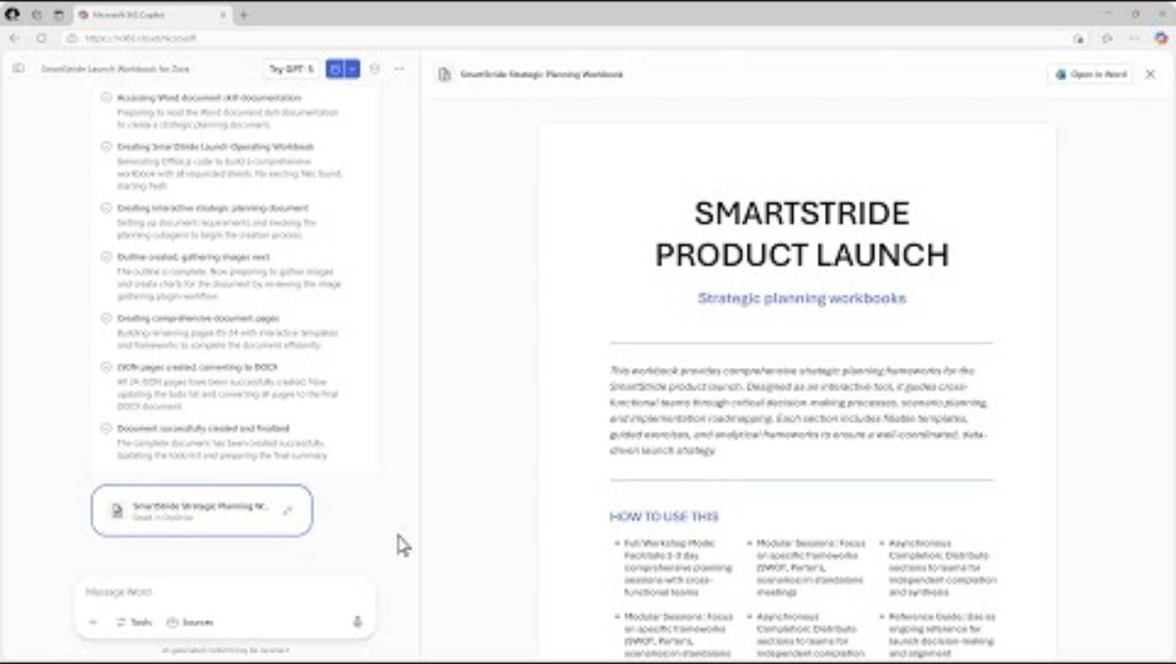
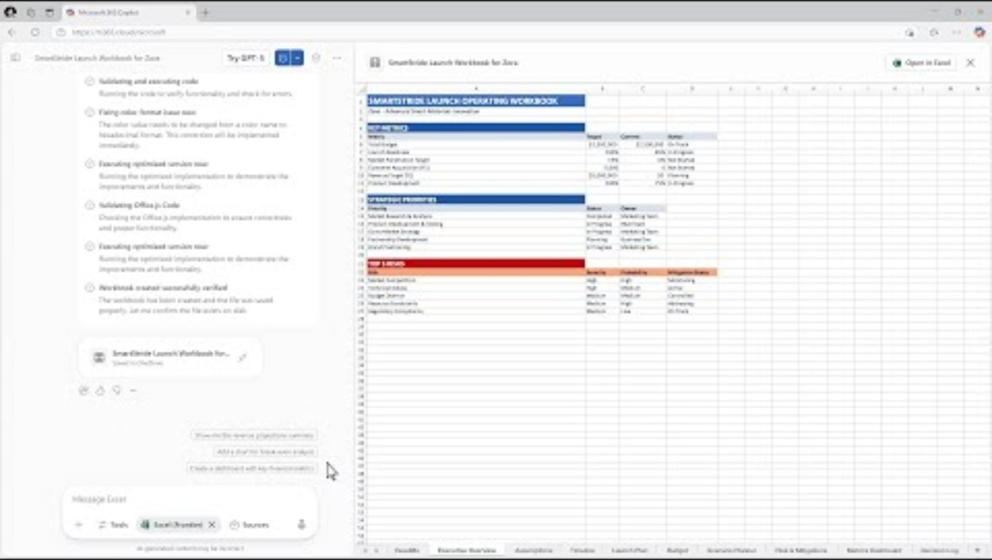
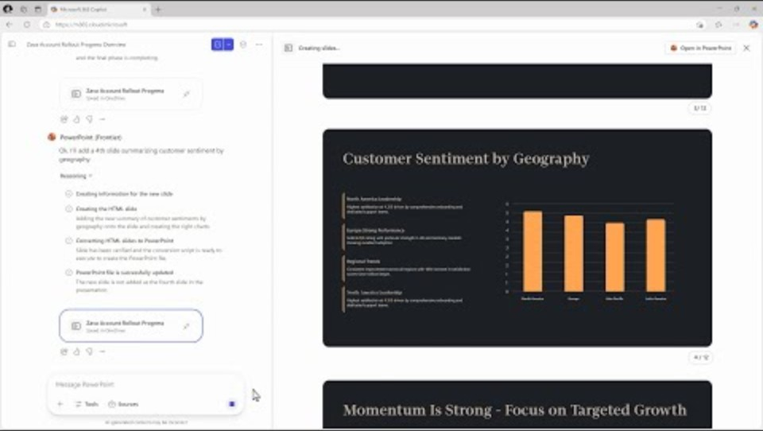
Word, Excel, and PowerPoint Agents in Microsoft 365 Copilot
Table of contents
Getting started
Microsoft 365 Copilot
Copilot
Chat
Prompt guidance
Turn natural‑language prompts into polished documents, spreadsheets, and presentations – and provide clarifying guidance on structure, formatting, and data sources to create new files from scratch. Just select an agent from Tools or @mention Word, Excel, or PowerPoint in Copilot Chat and type your prompt. Then, iterate with Copilot and when you’re ready, open in the app to continue editing with Copilot.
Using Word Agent
Use Word Agent in Microsoft 365 Copilot to quickly create drafts by leveraging your documents, meetings, emails, and web data.
TRY IT:
Create a customer proposal for/[customer/product] using the [file]. Include a cover page, Executive Summary, auto‑generated Table of Contents, styled headings, and standardized headers/footers.
Using Excel Agent
Generate working spreadsheets with formulas, logic, and clean tables with Excel Agent in Microsoft 365 Copilot
TRY IT:
Create a workbook called “Q2 Sales Plan“ with sheets for Pipeline, Actuals, and Assumptions. Fill the last 6 months with sample data for SMB/ENT across regions. Use clean tables and proper dates.
Using PowerPoint Agent
Create new presentations with PowerPoint Agent in Microsoft 365 Copilot, grounded in your work—so you focus on storytelling, not slide creation.
TRY IT:
Prepare a project update deck to share with leadership about [topic] using internal emails, meetings, and chats. Include any key risks.
*Word, Excel, and PowerPoint Agents are rolling out for Microsoft 365 users with and without a Copilot license. Learn more.
**Excel Agent only leverages web data currently.
Notes:
Agent Mode

Slide 6
Editing with Copilot: From draft to done
Table of contents
Getting started
Microsoft 365 Copilot
Copilot
Chat
Prompt guidance
Editing with Copilot brings agentic collaboration into productivity apps, enabling Copilot to edit directly in Word, Excel, and PowerPoint with transparent, reversible changes—grounded in your work and built for collaboration.
Unlike AI tools that stop after a first draft, Copilot stays in the document, spreadsheet, or presentation—working side by side with you and making app-native edits until the final version is ready.
Use the following prompts to see Editing with Copilot in action
Scenario | Edit with Copilot in… | Prompt
Quickly refine content | Word | Clean up the language and effectiveness of this content to be better aligned with/[brand guidelines file]?
Update a recurring business report | Word | Help me update this monthly report for [timeframe]. Update the data table with the latest numbers from the/[email with metrics or data].
Financial statements modeling | Excel | Create an annual financial close report for a bike shop business, including a breakdown of product lines across variance to budget (VTB) and year-over-year growth. Use dummy data for now, as well as standard financial formatting and best practices.
Analyze data to drive decision-making | Excel | Run a full analysis on this sales data set in this [Excel file]. I want to understand some important insights to help me make decisions about my business. Make it visual.
Analyze sales growth | Excel | [Use existing data set] Give me insights on how our sales are doing, including a breakdown of customer segments and where we have the most opportunity vs. risk. Show which regions are growing paid users faster than new customers and visualize the trends with charts.
Convert slide text into a visual chart | PowerPoint | [Use existing presentation]Transform text on this slide into a chart
Transform text to SmartArt | PowerPoint | [Use existing presentation] Replace the bullet list on this slide with a detailed SmartArt timeline
Support story-telling through images | PowerPoint | [Use existing presentation] Add a generated image that reinforces the main point of this slide
*Excel & Word: Generally available in Jan. 2026 for Windows desktop, Mac, and web for Microsoft 365 Copilot users (excluding EU/UK for Word). PowerPoint: Rolled out to Frontier in Nov. 2025 (Windows) and rolling to generally available on web started in February (excluding EU and UK).

Slide 7
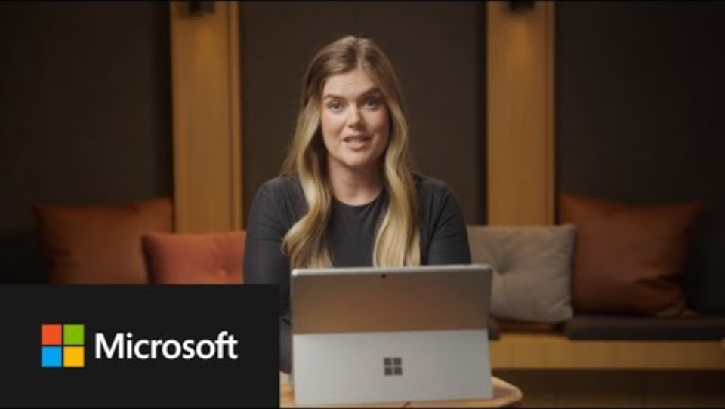
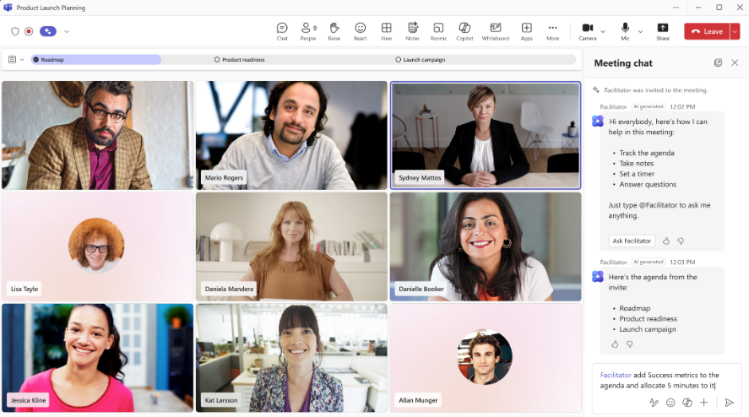
Using Microsoft 365 Copilot Teams Agents & Teams Mode
Table of contents
Getting started
Microsoft 365 Copilot
Copilot
Chat
Prompt guidance
Copilot in Teams brings intelligence directly into the flow of teamwork. Across conversations, meetings, and ongoing work, Copilot helps teams stay focused, capture what matters, and move from discussion to action.
Using Teams Mode
To begin using Teams Mode*, simply @Copilot in a Teams group chat or click Open Agents and bots in the upper right corner of Teams and select Copilot.
Here are a few ways to start group collaboration with Copilot:
Scenario | Prompt
Plan team events | Start a plan for your next team offsite in the Microsoft 365 Copilot app, then start a group chat with members of your team; everyone can @Copilot to suggest different agenda topics and organize logistics.
Explore new market opportunities | Use Copilot to explore a new market opportunity, then start a group chat with Finance, Sales, and Product teams; @Copilot to add data points, explore product comparisons, outline pricing benchmarks, and build the business case together.
Using Microsoft Teams Agents
Use Channel Agent when your team needs to…
Run a project with lots of moving parts or turn ongoing conversation into
structured action
Keep track of decisions, deadlines, and responsibilities
Reduce the time spent writing reports or updates
Ensure continuity when teammates join late or miss meetings
Use Facilitator agent to:
Keep meetings structured and on time
Support hybrid teams who need shared visibility
Give late joiners or absentees a quick way to catch up
Turn conversations into action — tasks, docs, summaries
Try the following prompts to see how it can work for you:
Scenario | Prompt
Create status updates | @Channel agent Create a status report on the latest updates. Include columns for status, this week’s focus, next steps, any help needed, and the due date.
Produce docs based on a meeting | @Facilitator Generate a strategy document for our product in Word
Try the following prompts to see how it can work for you:
*Teams Mode for Microsoft 365 Copilot is available in public preview for Microsoft 365 Copilot licensed users on desktop, mobile, and web.

Slide 8
Copilot Chat
Table of contents
Getting started
Microsoft 365 Copilot
Copilot
Chat
Prompt guidance
Prompts to try for Copilot Chat
To get started, tap Web toggle in the Microsoft 365 Copilot app or visit https://www.M365copilot.com. Copilot Chat is available at no additional cost to all Microsoft Entra ID users with an eligible Microsoft 365 subscription.
Scenario | Prompt
Develop a project plan | Review the attached project plan and give me five substantive ways to make it better; include rationale for your responses and specific text to insert into the plan.
Prepare an executive report¹ | Use the attached spreadsheet with customer feedback to create a polished executive report that helps upper management decide where to prioritize resources in our next cycle. [upload file]
Improve a document draft¹ | We have a draft press release [document]. Find a couple of similar recent announcements on the web and then suggest how to make ours stand out.
Gain subject-matter knowledge | Act as a financial compliance analyst, prepare a summary comparing the Dodd-Frank, Basel III, and MiFID II capital adequacy and reporting requirements for banks.
Visualize data quickly | Create a pie chart showing the market share of smartphones in the United States in 2024.
Understand the main point¹ | Recap the findings of this research paper: [upload file]. Highlight the surprising or potentially controversial results, if they exist.
Stand out on socials¹ | Craft an engaging LinkedIn post based on the content of [upload file].
Calculate the ROI | How much value will a $450,000 investment have after 5 years with an 8% return annually?
Improve your writing¹ | Rewrite my draft so it sounds more professional and less verbose [upload file].
Code faster | Write a python script to perform binary search.
Generate ideas¹ | Suggest 10 compelling titles for this document: [upload file].
Get writing recommendations | Analyze the text in the following and make suggestions on how to improve it: [insert text]
Visualize a scene¹ | Create an image with the running sneaker standing upright in a modern studio setting. The scene has a clean, minimalist design and the background includes a setting of simple minimalist gradients. [add an image]
¹ Image generation and file upload limits apply.

Slide 9
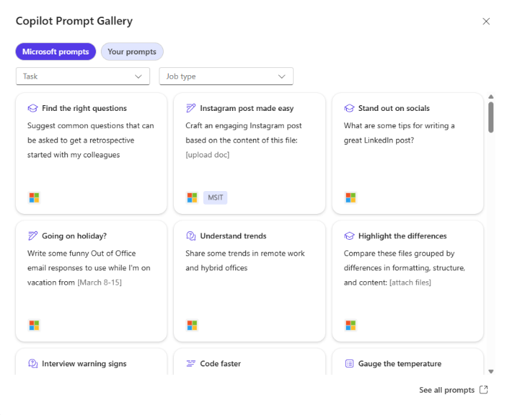
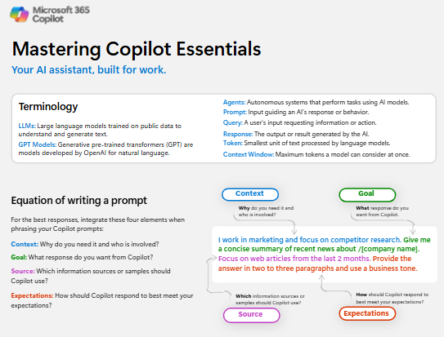
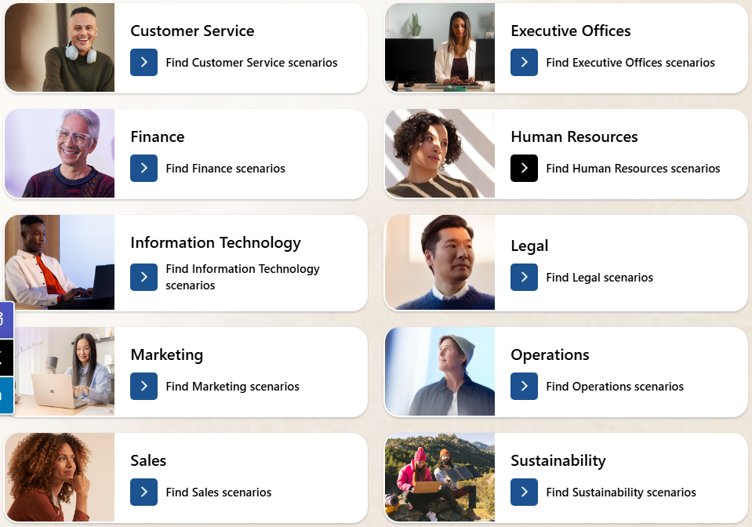
Additional Prompt Resources
Table of contents
Getting started
Microsoft 365 Copilot
Copilot
Chat
Prompt guidance
Copilot Prompt Gallery
Find prompting inspiration so you can take greater advantage of Copilot in your daily work.
Explore the curated selection of Copilot prompts
Save your favorite prompts
Share your favorite prompts with colleagues
Find prompting inspiration from others
Access the Prompt Gallery in Copilot Chat by selecting the box with star icon next to the prompt box. Here, you’ll see suggested Copilot prompts and your saved prompts.
Mastering Copilot Essentials
Get a simple overview of Copilot fundamentals—terminology, prompt structure, and quality criteria—to support users just beginning their AI transformation journey.
Microsoft Adoption Scenario Library
Find business function-and industry-specific scenarios to inspire your organization’s AI transformation journey.

