Slide 1
Agent Governance

Slide 2
Agenda
Spectrum of Agents and Controls
Management Controls
Security & Governance
Measurement & Monitoring
Planned Features
Resources
Next Steps & Call to Action
Notes:
Hello everyone. Today we'll discuss how to control, manage, and govern agents in Microsoft Copilot. We'll begin with an introduction to agents and Copilot's capabilities, then cover management, control, security, governance, measurement, and monitoring features. Finally, we'll review upcoming features, resources, and actionable next steps.

Slide 3
Spectrum of Agents and Controls

Slide 4


Spectrum of agents
Agents use AI to automate and execute business processes,
working alongside or on behalf of a person, team or organization
IT Helpdesk agent
Device Refresh agent
Lead Gen agent
How do I connect to the corporate network?
Request a new laptop and send approvals via IT Service tool.
The agent has identified and researched 15 new leads for you to review.
Simple
Advanced
Retrieval
Retrieve information from grounding data, reason, summarize, and answer
user questions
Task
Take actions when asked, automate workflows, and replace repetitive tasks for users
Autonomous
Operate independently, dynamically plan, orchestrate other agents, learn and escalate
Agents vary complexity and capabilities depending on your need
Notes:
Before discussing agent governance, it's crucial to understand the types of agents you can create in Copilot, as governance features depend on agent type and building tools. Agents range from basic retrieval agents, which use a data source to generate answers, to those equipped with tools for performing actions, and finally to autonomous agents that act independently based on organizational signals.

Slide 5

Types of agents
Declarative agents
Custom engine agents
Copilot Studio Lite
Copilot Studio
SharePoint
Agent Toolkit in Visual Studio Code
Copilot Studio
Agent Toolkit in Visual Studio Code
AI Foundry
Build with
Agent runtime
Microsoft 365 Copilot
Bring your own orchestrator and foundation models
Microsoft 365 Copilot
Microsoft Teams
SharePoint
Web + 10 other channels
Microsoft 365 Copilot
Microsoft Teams
SharePoint
Deploy across
Notes:
In Microsoft 365, you can create two types of agents: declarative and custom engine agents. Declarative agents are built on the Copilot architecture and use OpenAI models, with Microsoft handling orchestration and interface; you simply add the needed knowledge or tools using platforms like Copilot Studio Lite, Copilot Studio, or SharePoint agents. These run only within Microsoft 365. For more complex needs or wider deployment, build custom engine agents using your own models and tools such as Copilot Studio (low code), Microsoft 365 Agent SDK, Azure AI Foundry, or Visual Studio Code (pro code).

Slide 6



Agents built by Microsoft in Microsoft 365 Copilot
Researcher agent
Generally available
Analyst
agent
Generally available
Skills
agent
Frontier
Available to users with a Microsoft 365 Copilot license, these agents are readily available in Copilot Chat and across core apps you use every day, helping organizations achieve quicker time to value. They add specialized skills and knowledge to Microsoft 365 Copilot, taking on unique roles to drive business value.
Facilitator
agent
Public preview
Interpreter agent
Public preview
Project Manager agent
Public preview
Notes:
Using agents isn't limited to building them from scratch. In your organization, you have access to first-party agents included in Copilot Light, such as Researcher, Analyst, and Facilitator. These agents are part of Copilot and can be managed just like any other agent within your organization.

Slide 7
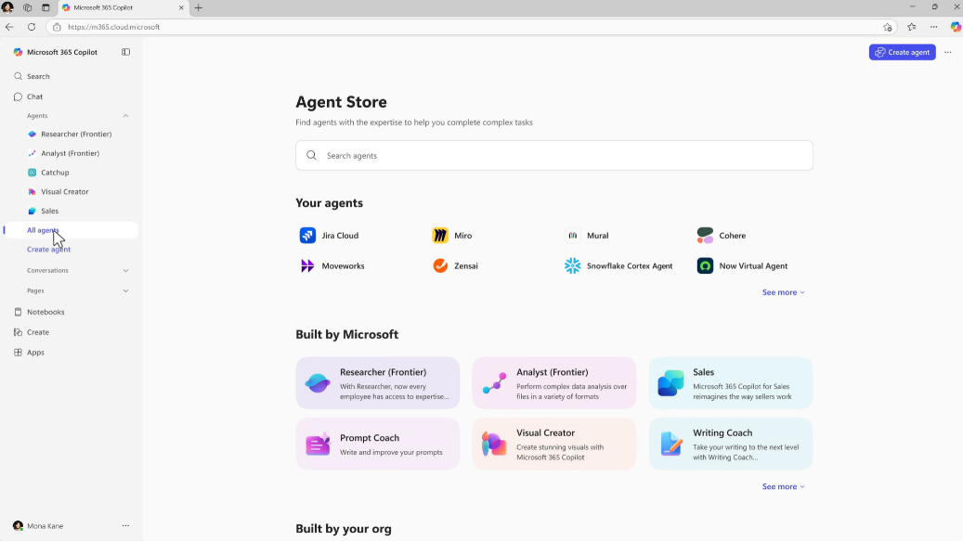
Agents Store
Agent Store is an agent marketplace featuring agents from Microsoft, partners and customer organizations
Its immersive and personalized experience helps you find and use agents to transform work processes and elevate productivity
Share agents with colleagues via Copilot Chat or other Microsoft 365 Copilot endpoints to boost collaboration
IT admins have full visibility and control over how agents are deployed in their organization
Note: Agents embedded in M365 apps are not available in the Agent Store
Notes:
You can acquire agents from the agent store, a marketplace featuring agents created by colleagues, ISVs, and partners for your organization. As a tenant administrator, you have full control over which agents are available to users through the Microsoft Admin Center.

Slide 8
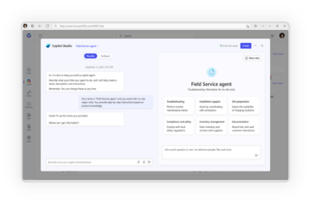
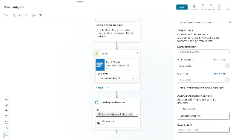
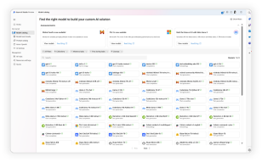
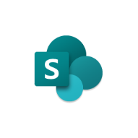

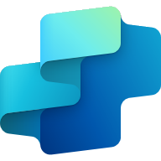

Advanced agents require more advanced governance and security
Conversational
Advanced
Copilot Studio Lite
Copilot Studio
Copilot Studio + Azure AI
Users/Creators
Makers
Developers
Knowledge
Microsoft Graph
Your Business Data
Actions
Retrieval Only
Task / Autonomous
Channels
Microsoft 365 Only
Multiple Internal & External Channels
Increasing advanced governance and security needs
throughout agent lifecycle
1. Development & Testing
2. Deployment
3. Optimization
Notes:
There are many tools and features available for building agents, such as Copilot Studio Lite, Copilot Studio, and Azure Foundry. As agents become more advanced, strong governance and security become essential due to their increased capabilities. We provide tools to help you effectively manage agents in your organization across any stage or scenario.

Slide 9

Copilot Control System
Copilot + Agents
Management Controls
Security & Governance
Measurement & Reporting
Licensing & metering
Agent lifecycle
Customization
Data security
AI security
Compliance & privacy
Readiness and adoption
Productivity impact
Business value & ROI
Notes:
Understanding the copilot control system is crucial for agent governance in Microsoft 365. This system includes tools for managing and controlling copilots and agents. We’ll dive into three main pillars: management controls (covering licensing, lifecycle, and agent customization), security and governance (focusing on data security, compliance, and privacy), and measurement and reporting (using dashboards and reports in Power Platform to track organizational usage of copilots and agents).

Slide 10
Management Controls

Slide 11
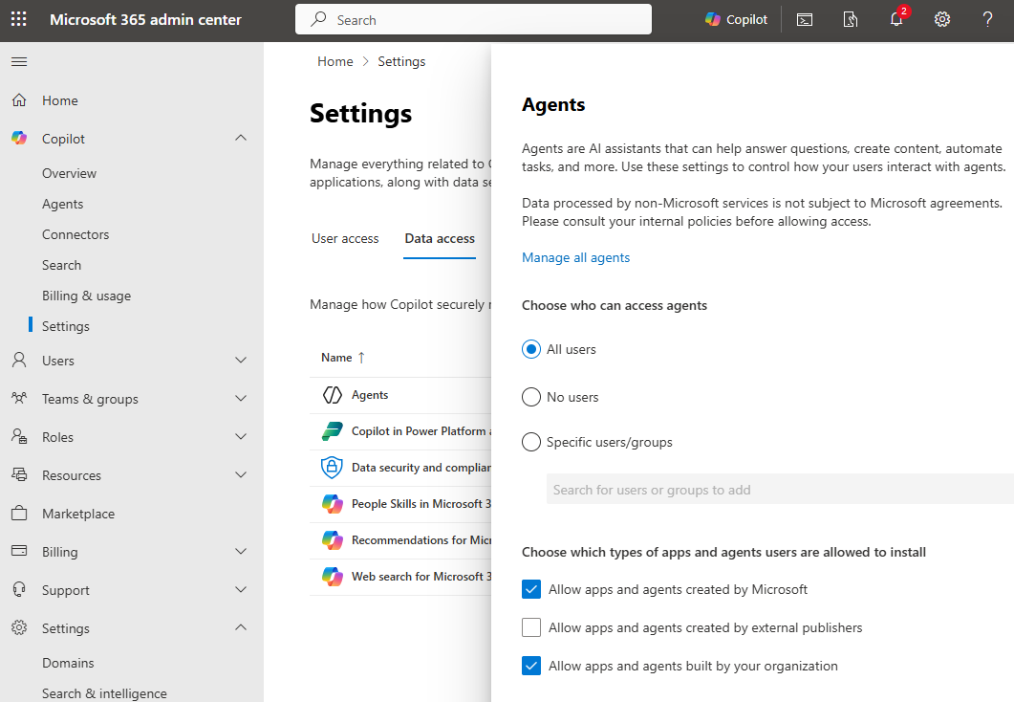
Use Copilot extensibility control to control agent access in Copilot Chat
IT admins can control who are able to create and use agents in Copilot Chat
Options are all users, no users or specific groups/users
This option is also available in
  Copilot > Settings > Data access > Agents
  Settings > Integrated Apps > Available Apps
This control doesn’t govern SharePoint agents
Define which types of apps and agents are allowed to be installed
Notes:
Management controls begin with agent settings in Microsoft Admin Center, allowing you to specify who can use agents—everyone, no one, or selected users/groups—at either a global or group level. Note that this control currently affects only agents accessed through Copilot chat, not SharePoint agents, and applies to both using and creating agents. Blocking access prevents users from both using and creating agents within your organization.

Slide 12
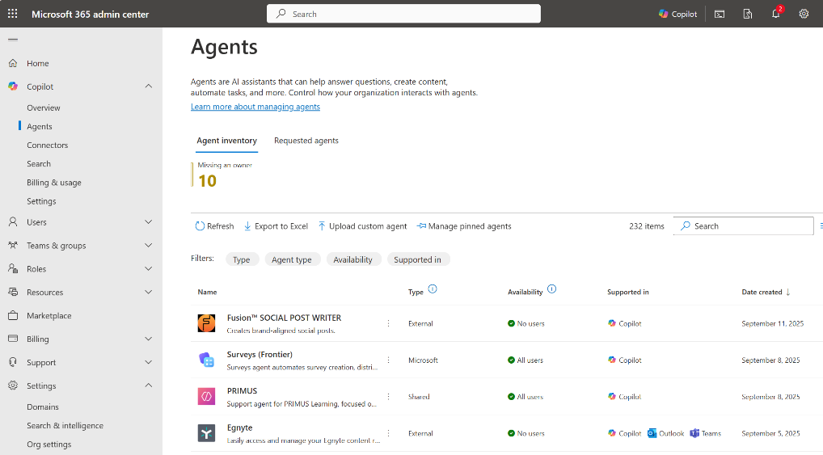
Agents management
Agent Inventory & Metadata: View all agents -store, Microsoft, external, and shared - with metadata like capabilities, data sources, and custom actions.
Access Controls: Scope agent availability by user or group, block or delete agents
Lifecycle Management: Ownerless agents, transfer ownership (Coming Soon), monitor usage (reports), and enforce governance policies across the agent spectrum -from end-user-created to IT-managed agents.
Staged Rollouts: Control agent visibility and deployment pace across the organization.
Notes:
We now have an Agents Management dashboard, which organizes all agents in your organization—regardless of whether they were created by Microsoft, internally, or by ISVs—in one place. Previously, agents appeared in the app catalog mixed with other apps, but now you can easily view, block, scope, and manage agents directly. The dashboard also identifies orphaned agents and will soon allow ownership transfers, addressing common scenarios such as transferring agents when employees leave the organization.

Slide 13
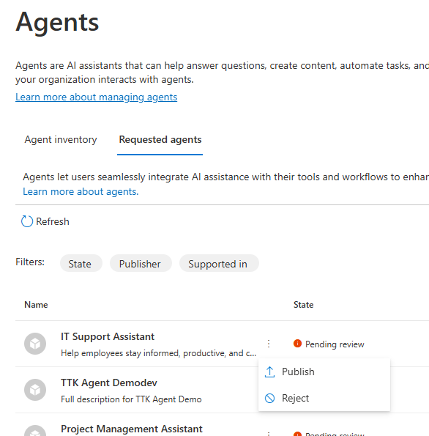
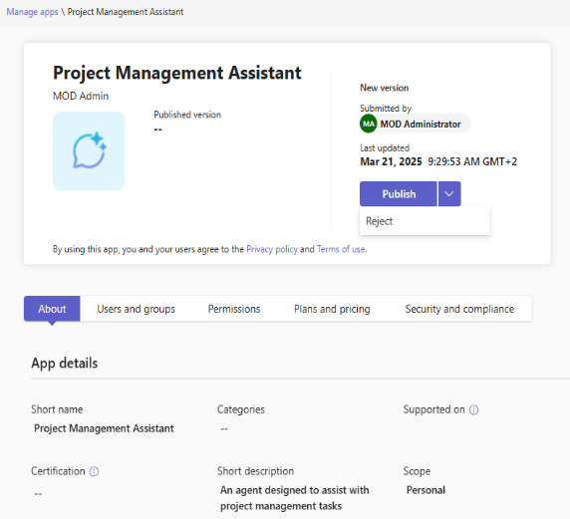
Agent admin approval
Agent authors can publish their agents created in Copilot Studio or Agents Toolkit to tenant’s app catalog
Admins need to approve/reject publishing which can be done in
MAC > Copilot > Agents
TAC > Manage Apps
Publishing new version of the agent also requires admin approval
Notes:
When users create agents using Copilot Studio or the pro-code method, they can choose to publish their agent in the organizational catalog—which serves as the agent store and makes the agent accessible to everyone in the organization. Because this is so important, publishing an agent in the catalog always requires administrator approval. In the agent inventory section, there's a tab called "requested agents." Whenever someone submits an agent for publication in the organizational catalog, the administrator will see the request there and can decide whether to approve or reject it.

Slide 14
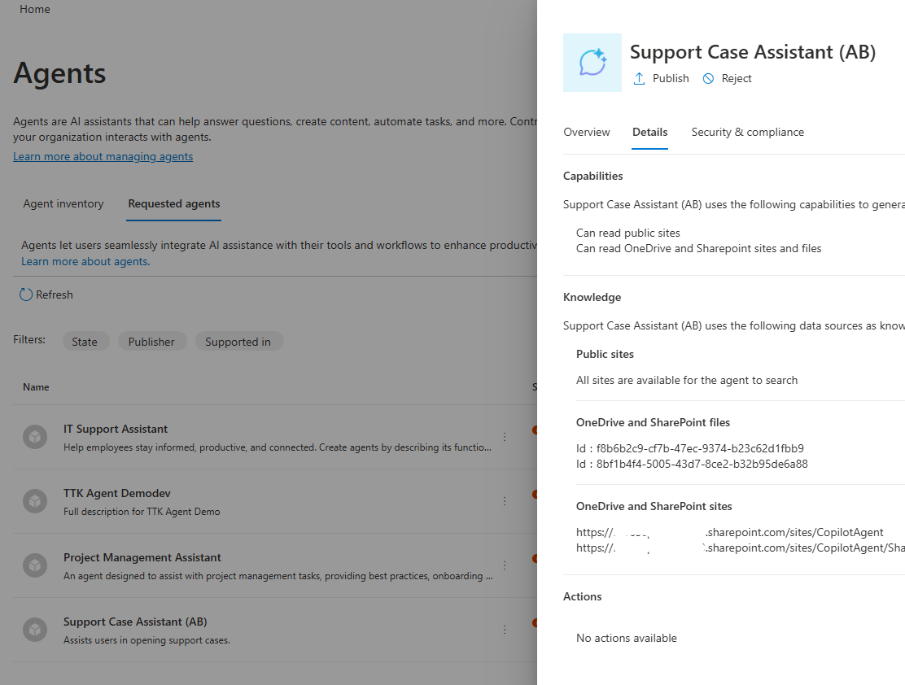
Review agent metadata before making agents available
When an agent is submitted for admin approval, all metadata about agent definition is provided on app details tab in Copilot > Agents > Requested agents to equip M365 admin with all information about the agent, including capabilities, data sources, and custom actions that the agent can invoke.
Same details are not available in Teams Admin Center
Notes:
Administrators can use a panel to access all agent metadata by clicking on any request. This allows you to see the agent's capabilities, knowledge, and actions, helping you quickly assess whether the agent is safe to publish or if further review with the developer is needed.

Slide 15
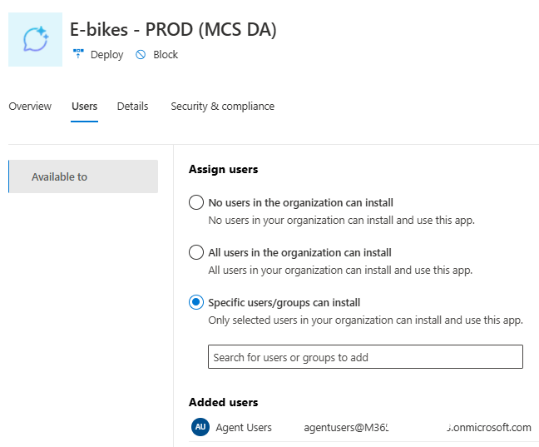
Control published agents
After agent has been approved and published, admins have following controls in Microsoft 365 and Teams Admin Centers
Define who can access the agent
Deploy app to target audience
Notes:
Once you publish an agent—whether built internally or sourced from partners or ISVs—you can control its visibility in the agent store by assigning access to specific groups. This allows you to segment agents, such as making a finance agent available only to the finance team. Alternatively, you can deploy agents directly to a target audience, enabling immediate access without installation; agents will appear automatically in Copilot chat for those users.

Slide 16
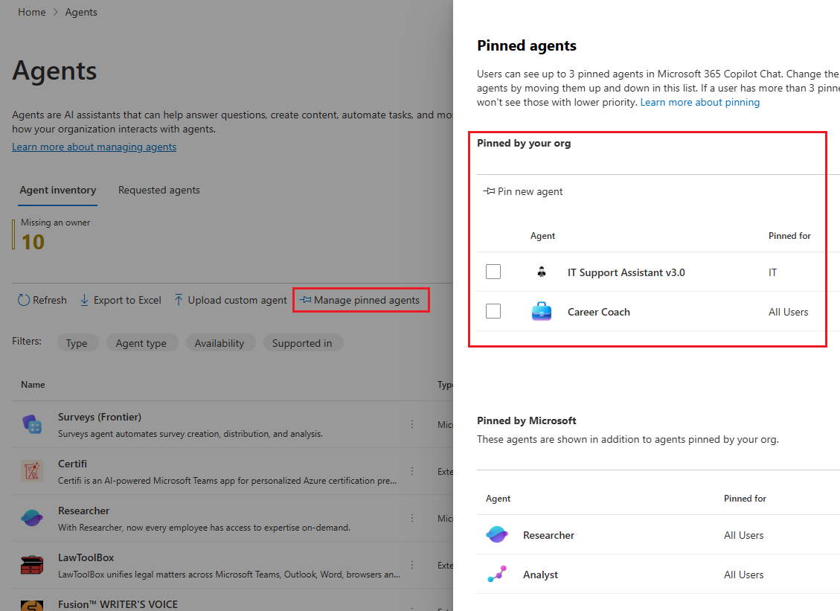
Manage Pinning of Agents
Pinning agents is a feature that enables administrators to preselect and pin maximum three agents for end-users using Microsoft 365 Copilot.
The administrator pins the agent to ensure that it is automatically listed in the end user's Copilot interface without requiring any user action.
The agent is now readily accessible to the user in the Copilot interface.
Notes:
We've added a feature that lets you pin up to three important agents in the copilot chat panel, making them easily accessible for your employees. This helps boost productivity and reduces internal requests by encouraging frequent use of key agents.

Slide 17
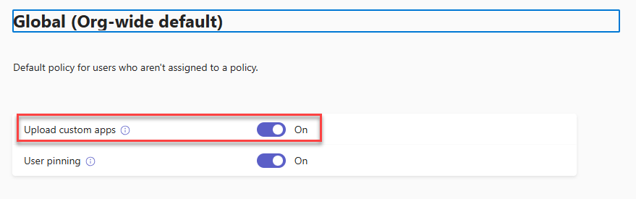
Control custom app uploading - sideloading
You can use the Teams setup policies to disable uploading custom apps and agents
Administrators can block sideloading by:
Changing the global policy (for everyone)
Creating a custom policy (if you want to target only specific users or groups)
Sideloading can be blocked at tenant level or only to specific users / groups
Notes:
To upload agents built with the pro code approach, use side loading—manually uploading a zip package (with manifest and agent data) to the catalog. For agents created with the M365 toolkit, this process is required for testing and deployment. Side loading can be managed in the Teams admin center by enabling or disabling the policy globally or restricting it to specific users or groups through custom policies.

Slide 18
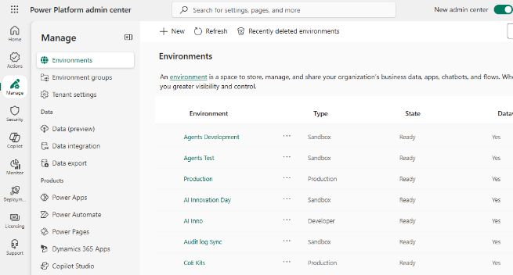
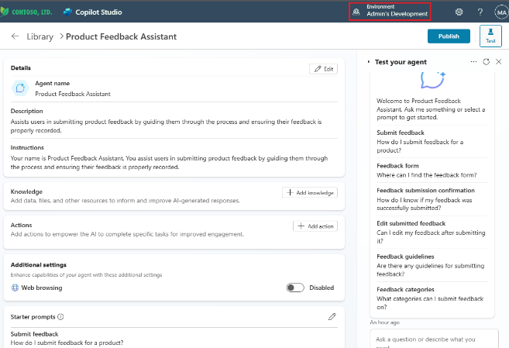
Power Platform Environments
An environment is a space to store, manage, and share your organization's business data
Agents build in Copilot Studio are stored in an environment like Power Apps and Power Automate flows for example
Environments can have different roles, security requirements and target audiences
Managed Environments provides a suite of premium capabilities that allows admins to manage Power Platform at scale with more control, less effort, and more insights.
Environment Groups allows admins to define rules (environment level settings) automatically applied for new and existing environments
Notes:
The copilot agent narrative is deeply integrated with Copilot Studio and Power Platform. This tool, included with your Microsoft 365 copilot license, is one of the most powerful resources available for building agents. Copilot Studio stands out as the most robust and adaptable option, especially when paired with pro-code approaches, because it offers complete access to agent capabilities. With Copilot Studio, you can incorporate knowledge, tools, triggers, enable multi-agent scenarios, and even publish agents to the catalog, making it an invaluable asset.
Given its versatility, proper management of this tool is crucial. Fortunately, if you’re already familiar with Power Platform, you’ll find that Copilot Studio adheres to all of Power Platform’s governance features. One core concept is "environments." These are spaces designed to store, manage, and share agents, allowing you to organize them based on your preferred criteria—such as by department or development stage (like developer, production, or testing environments).
Environments are fundamental because, as covered later in the presentation, Power Platform offers capabilities like managed environments and DLP policies that you can assign to specific environments, controlling what users can do within each space. This means some environments can be tightly restricted while others might encourage sharing, providing precise governance and control over your organization’s agents.

Slide 19
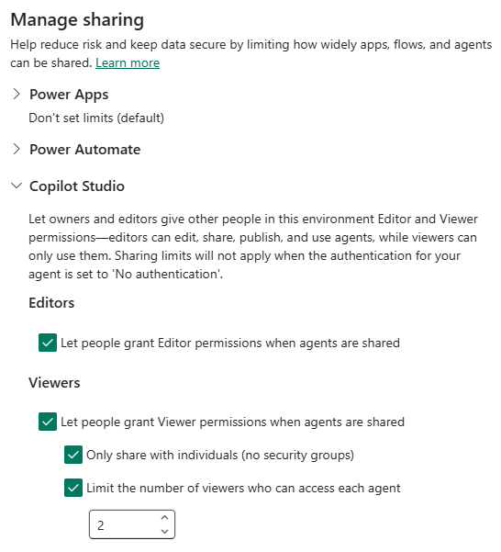
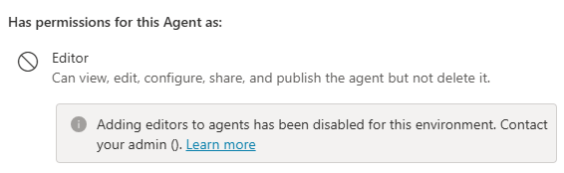
Block and limit sharing for Copilot Studio Agents
Sharing limits is a new type of guardrail available to admins in the Power Platform admin center for Managed Environments
Allows admins to block and limit sharing for agents, created in Copilot Studio, in the following ways:
Allow or block makers from sharing agents with individuals as editors
Allow or block makers from sharing agents with viewers. This applies to individuals and security groups
Allow or block makers from sharing agents with security groups
Set a numerical limit on the number of viewers an agent can be shared with
Does not affect publishing to tenant app catalog
Notes:
One key feature is sharing management within the Power Platform's managed environment. By designating an environment as managed, you gain additional controls, such as determining whether users can create agents, restrict sharing with editor permissions, or require publishing only to the organizational catalog. This enables precise oversight of agent sharing and addresses concerns about uncontrolled agent proliferation, allowing administrators to maintain visibility and enforce restrictions.

Slide 20
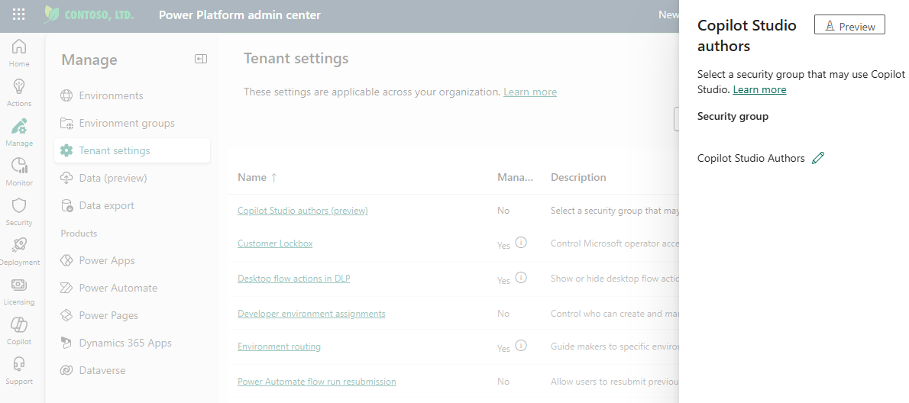
Copilot Studio Authors
Admins can use security group or Microsoft 365 group to control which users who does not have any of the following licenses can access to Microsoft Copilot Studio
Microsoft 365 Copilot
Copilot Studio User License
Copilot Studio Viral Trial
Notes:
Copilot Studio now allows anyone in your organization to create agents, even without a copilot license, using credits or pay-as-you-go. To manage access, a new tenant setting called Copilot Studio Authors lets you choose who can use Copilot Studio among unlicensed users. Note: This only applies to those without any other license; licensed users bypass this setting.

Slide 21
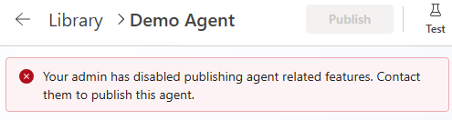
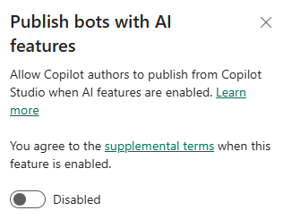
Publish bots with AI features
Disable agent publishing in tenant level. If disabled, users can still create agents but not publish
Applies to both declarative and custom engine agents
Notes:
If you're early in adopting agents and want to prevent publishing at the global level, you can disable bot publication with AI features. This ensures that while users can create agents, they will not be able to publish them organization-wide.

Slide 22
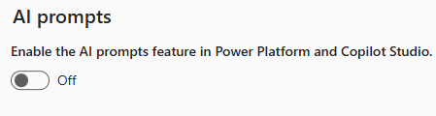
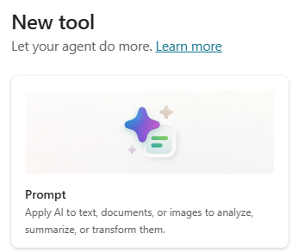
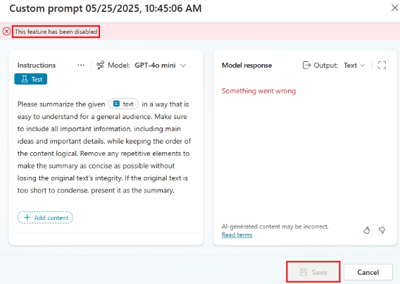
Control AI prompts feature
By default, the AI prompts feature is enabled for makers to create and experiment with various AI-generated content.
Admins can enable or disable this feature as needed.
If AI prompts are disabled, users cannot create and use custom or prebuilt prompts in agents
Environment level setting and available as rule in environment groups as well
Notes:
AI Builder lets you create specialized prompts using custom models tailored for your agent’s scenarios. This feature can be managed at the tenant level, allowing you to disable it so users cannot publish or save custom prompts within the Power Platform.

Slide 23
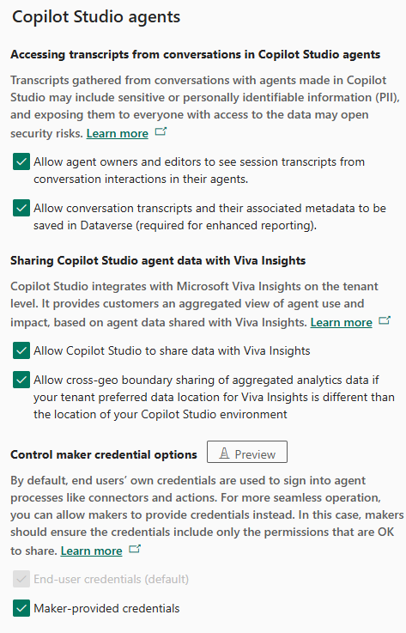
Copilot Studio agents settings
Power Platform environment level settings for Copilot Studio agents:
Accessing transcript from conversations in Copilot Studio agents
Sharing Copilot Studio agent data with Viva Insights
Control maker credential options (preview)
All these are available as rule for Environment Groups
Notes:
The environment includes specific settings for managing copilot studio. There are several features available, such as allowing copilot studio agents to access conversation transcripts and share agents with different sites. A new preview feature lets you control the maker credential. All of these rules are new and tailored for environment groups that work with copilot agents.

Slide 24
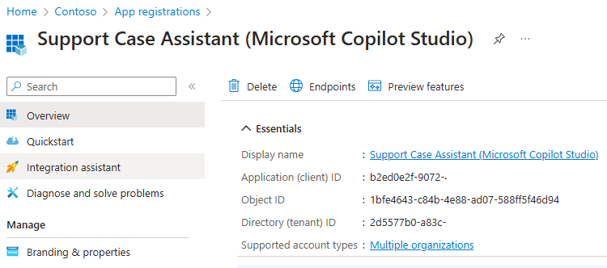
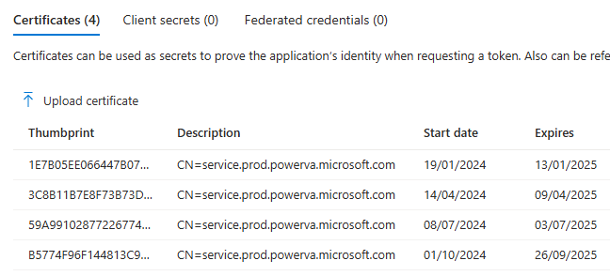
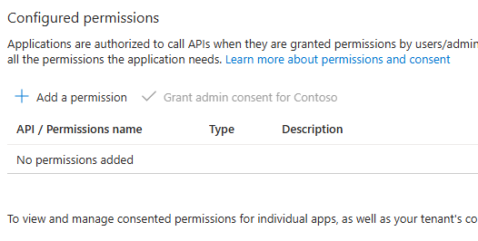
Copilot Studio Agents - Entra ID Application Registration
Copilot Studio creates one app registration per agent to identify it and enable secure communication with the channels it may use.
The app registration is for validating and securing calls from Copilot Studio to Azure Bot Service resource.
This app registration does not access or expose any customer data, resources, or any agent information.
Copilot Studio manages the registration for the application, so no administrator actions needed
Notes:
For your information, each time you create an agent in Copilot Studio, an app registration is automatically generated for that agent in Microsoft Entra. This process is necessary to facilitate communication between Copilot Studio and the Azure Bot service operating in the background. The app registration does not provide access to or expose any customer data or resources; it is fully managed by Copilot Studio. We are sharing this information so that, should you notice registrations appearing in Entra ID, you will understand that they result from Copilot Studio usage.
https://learn.microsoft.com/en-us/microsoft-copilot-studio/security-faq#copilot-studio-creates-a-multitenant-azure-app-registration-on-custom-copilot-creation-does-a-multitenant-azure-app-registration-for-custom-copilots-pose-any-security-risk

Slide 25
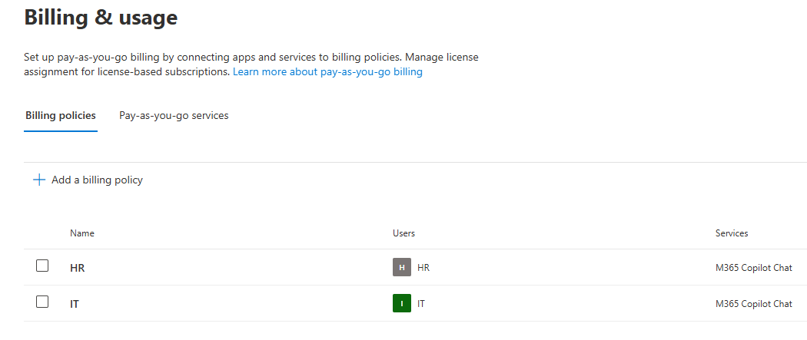
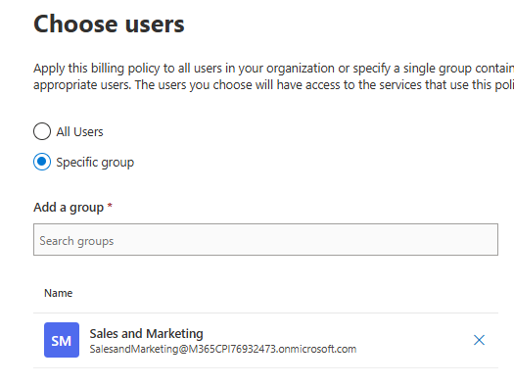
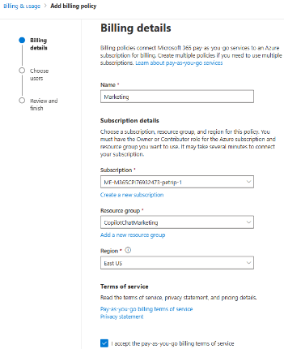
Copilot Chat pay-as-you-go billing in MAC
Admins can configure Copilot pay-as-you-go Billing Policies for Microsoft 365 Copilot Chat in the M365 Admin Center
Requires Azure subscription and resource group(s) created for policies
Possibility to create policies for all users and/or different group of users in “departmental” fashion leveraging M365 or Security groups
Notes:
As previously mentioned, I will be discussing the remaining controls before proceeding to billing policies. Some questions have arisen regarding the pay-as-you-go billing model, particularly about its configuration options. The billing plan can be established within the M365 admin center, where pay-as-you-go plans for chat require an active subscription.
Additionally, integration with an Azure Resource Group is necessary, linking it to either the environment or tenant, which enables billing functionality for both Gopala chat and Gopala chat agents within the Azure subscription.
We now also offer departmental billing capabilities, allowing multiple billing plans to be set up for distinct departments within an organization. For example, the HR department may have its own billing plan, as could the IT department, facilitating targeted cost allocation and distribution across organizational units based on usage by specific groups linked to individual billing plans. Service security groups or M365 groups can be employed to define access rules for each billing plan. In practice, departments such as HR or IT can be associated with dedicated security groups, thereby enabling clear differentiation of costs among various departments throughout the organization.

Slide 26
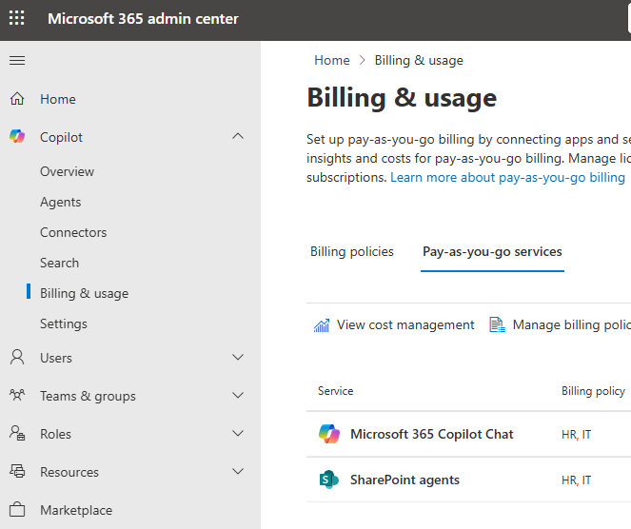
SharePoint Agents pay-as-you-go billing in MAC
Admins can configure billing policies for SharePoint agents in the same way as for Microsoft 365 Copilot Chat in M365 Admin Center
Has same requirements to have Azure subscription and resource group(s) created for policies
SharePoint is own pay-as-you-go service including same features as Microsoft 365 Copilot Chat as well like departmental billing and budget limits
Notes:
In the M365 admin center, similar configuration options are available for SharePoint agents. Administrators can either establish a dedicated billing plan for SharePoint agents or integrate them as a pay-as-you-go service within an existing billing plan. The requirements remain consistent in both scenarios; an Azure subscription and resource group must be linked to the tenant. If the billing plan is intended exclusively for SharePoint agents, these parameters are specified accordingly. However, it is also possible to include multiple services under one billing plan. For instance, if managing IT or HR services, the same billing method can be applied at a departmental level for different types of services or agent groups.

Slide 27
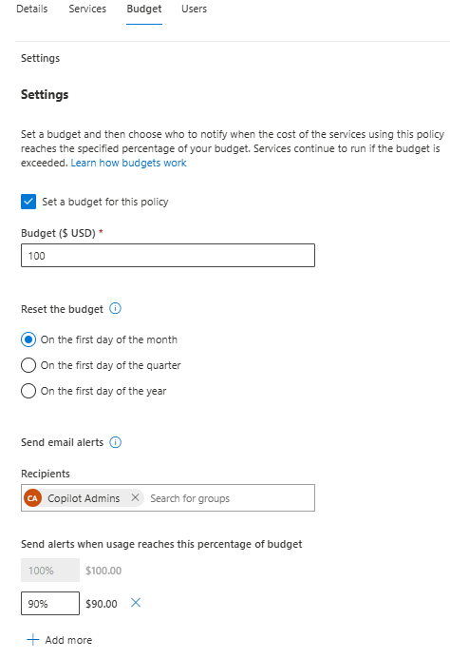
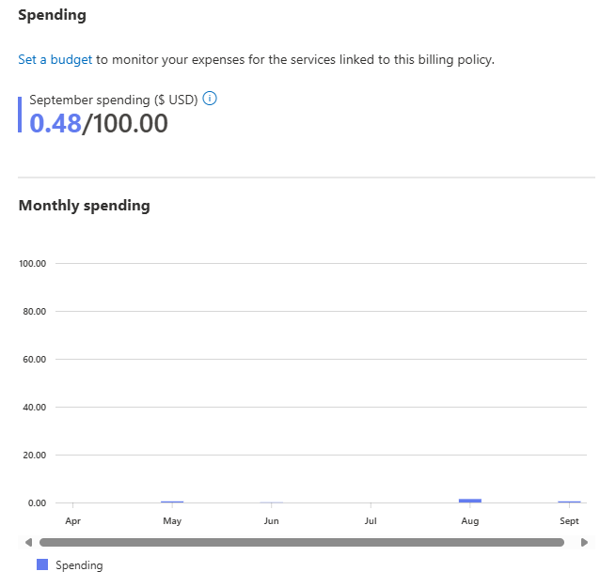
Billing plan budget limits in MAC
Admins can also configure budget limits for billing plans in MAC
Send email alerts to specified groups when usage reaches defined percentage of the budget
See spendings per month
Notes:
We now have building plans with budget limits. This allows us to set a maximum amount—such as $1000 per month—for each plan, though currently these limits are only used for monitoring and alerting rather than enforcement. We can create groups of people to be notified when spending approaches the budget limit. Up to four additional thresholds can be added; by default, notifications are sent at 100% usage. When the budget limit is reached, an email alert is sent to the selected group, but no action is taken to stop usage yet—this may change in the future, potentially allowing us to disable agents or billing for that plan. For now, these notifications help track spending, and reporting tools are available to show monthly usage and costs for each building plan.

Slide 28
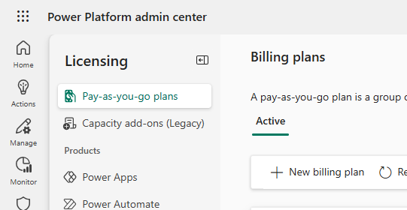
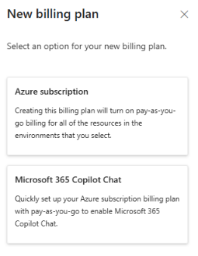
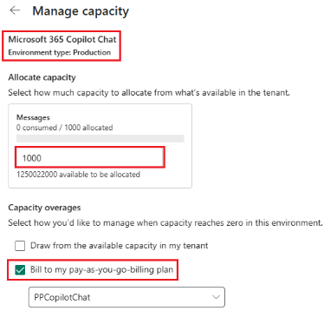
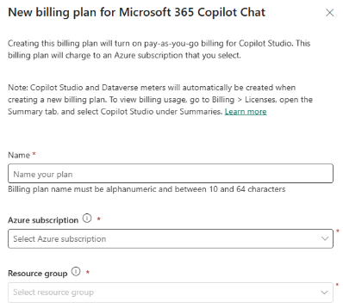
Copilot Chat pay-as-you-go billing in PPAC
Another option to configure pay-as-you-go billing plan is to in Power Platform admin center Licensing > Pay-as-you-go plans
Recommendation is to configure pay-as-you-go in MAC as it supports multiple billing policies
If you want to use pre-paid message packs, then currently only option is to configure billing plan in PPAC which allows us to assign messages to environments.
Requires fallback to pay-as-you-go billing
No Copilot Chat billing policies configured in MAC
Notes:
Billing plans can be configured in both the Power Platform Admin Center and the M365 Admin Center. However, it is recommended to use the M365 Admin Center for configuration, as the Power Platform Admin Center does not support departmental billing options or budget limits. Both centers require the same Azure subscription resource group.
Currently, the main advantage of configuring billing in the Power Platform Admin Center relates to the allocation of prepaid credit packs. If prepaid credits are available within the tenant, these can be allocated for the M365 Copilot Chat environment created for the billing plan, provided pay-as-you-go billing is enabled and no billing plan is set up in the M365 Admin Center. In cases where two billing plans exist, double charging does not occur; the plan in the M365 Admin Center takes priority.
Documentation indicates that configuration should be possible via the M365 Admin Center, and soon an option to enable Studio credits will be available there. Once this feature is released, tenants with credit packs will be able to leverage them for building plans in the M365 Admin Center as well.

Slide 29
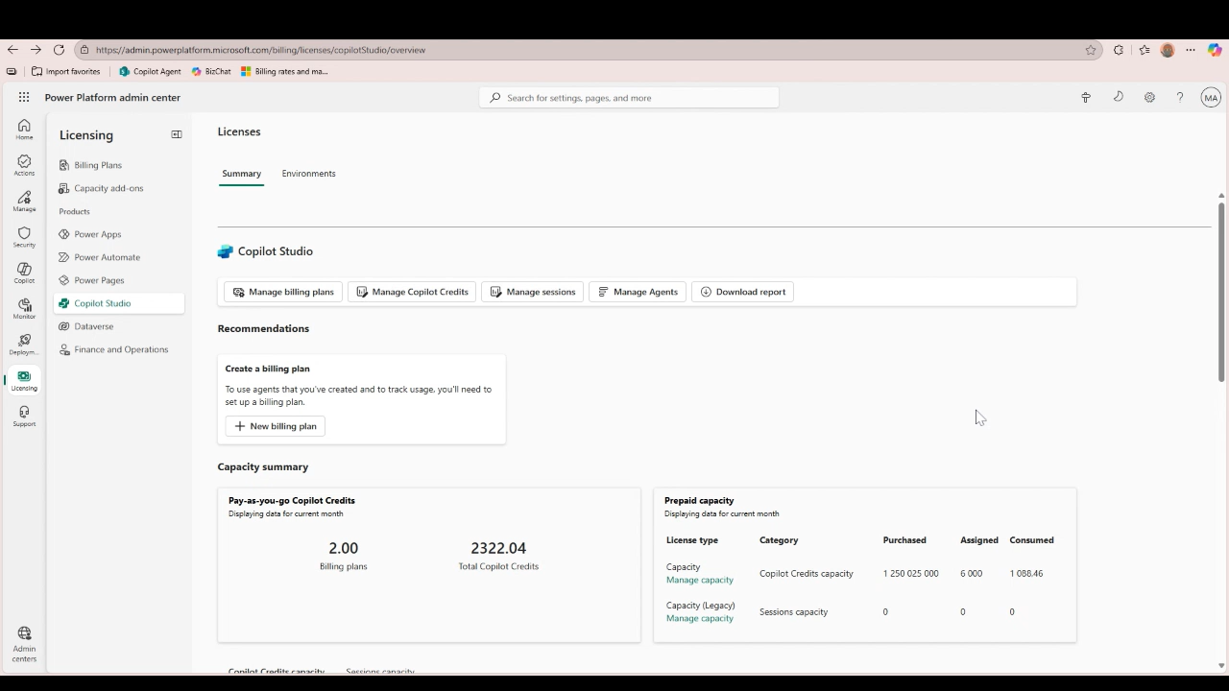
Set agent level capacity limits
Agent level insights and cost management for complete 360 view into your agent ecosystem
Set credit limits and track against those limits.
Set automatic triggers against capacity limits (warning email when close to limit followed by shut off)
Admin can easily access in the Power Platform admin center under Licensing Hub -> Copilot Studio
Notes:
Agent capacity limits can now be set in the Power Platform admin center for Copilot Studio agents. You can define agent-level caps, choose when to receive notifications as limits are approached, and optionally disable the agent once the set limit is reached. A number of new features—especially for pay-as-you-go—are on the public roadmap, which we will highlight at the end of this presentation.

Slide 30
SharePoint Advanced Management (SAM)
Key features for M365 Copilot Agents governance
    is a site-level setting that needs to be propagated to the search index, allows you to configure policies, leaving the site access unchanged but preventing the site’s content from being surfaced by Copilot or organization-wide search. It can be controlled granularly for both Team and Communication site types. RCD turns off all agent related activities for the site
    Restricted Content Discovery (RCD)
    Restricted Access Control (RAC) Policy
in SharePoint Advanced Management (SAM), is a powerful tool for enhancing security and governance. RAC policies allow you to restrict access to specific sites and content exclusively to designated user groups
    reports, currently in public preview, provides admins with a bird’s eye view of all site permissions across SharePoint, OneDrive, and files to help discover potentially over-permissioned content across the tenant. This empowers admins to address those sites
    to ensure results delivered by Copilot or search are limited only to the users who should have access to that information
    Data Access Governance (DAG)
Notes:
SharePoint advanced management provides a powerful set of tools to reduce risk of oversharing, control content sprawl and manage SharePoint site lifecycle. It is a collection of over 30 capabilities and is available now for “M365 Copilot” licensed users.
The key features related to Copilot and agents are…
Restricted Content Discovery – is a site level control we can use to block site content visibility in M365 search and Copilot. This provides also a way to disable Agents functionality completely in site. But be careful with this control as its overuse can affect search, SharePoint, and Copilot performance
Restricted Access Control – policy allows us to restrict access to site content only for users who are members of site owners and members groups or others groups which can be also defined in the policy. So, even if some document(s) are shared with user but if that user is not member of any of those groups then after the policy is applied, they can’t access the content anymore directly nor can see content in search or Copilot responses
Data access governance – reports helps admin to check for oversharing, content sprawl and manage inactive / obsolete sites. This is not just agents related feature but very important when planning to rollout Copilot and agents in the organization

Slide 31
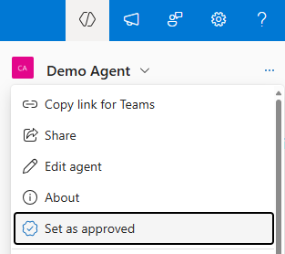
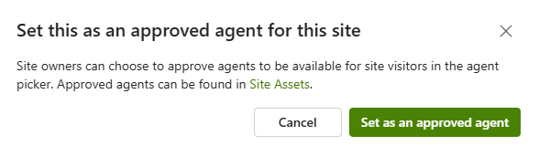
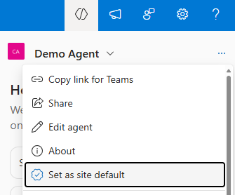
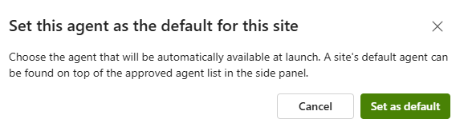
SharePoint site owner controls
SharePoint site owners have following controls for the agents created in their site
Approve agent
Set as site default agent
Notes:
SharePoint offers limited admin controls for agents, but site owners can approve agents on their sites. Approved agents are highlighted and appear first in the agent list, visible to anyone with site access. Any approved agent can be set as the site's default agent. Every modern SharePoint site receives a default agent upon creation, which cannot currently be deleted, though future updates may allow changes. For now, the default agent can only be replaced with a custom agent.

Slide 32
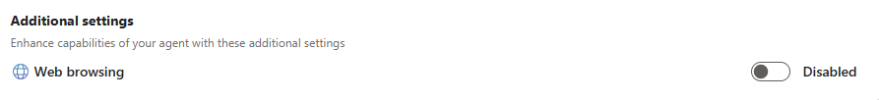
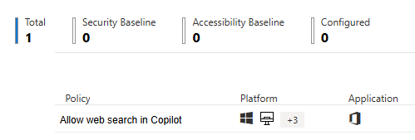
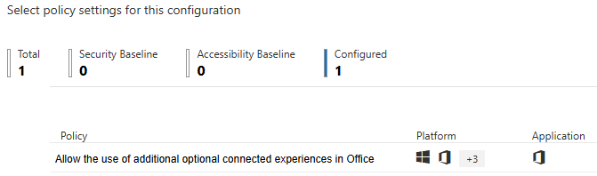
Control Copilot Web Search (web grounding)
Agents can leverage public content available on the internet when responding user’s prompts. Agent maker is able to enable/disable web grounding (web search) in the agent additional settings
Web grounding can be enabled/disabled in tenant level by admins using Allow web search in Copilot policy
Enabled in Microsoft 365 Copilot and Microsoft Copilot
Disabled in Microsoft 365 Copilot and Microsoft Copilot
Disabled in Microsoft 365 Copilot Work mode; Enabled in Microsoft 365 Copilot Web mode and Microsoft Copilot
Notes:
In agents, web content or web search can be used as a knowledge source, which is managed through config.office.com. The 365 Admin Center provides a policy to enable or disable this feature. By default, if not configured, web search is enabled. You can either disable it entirely in M365/Microsoft Cobalt or only in work mode while leaving it enabled in web mode. These options control Bing web search functionality for agents.

Slide 33
Security & Governance
Notes:
OK, let's then jump to the security and governance controls.

Slide 34
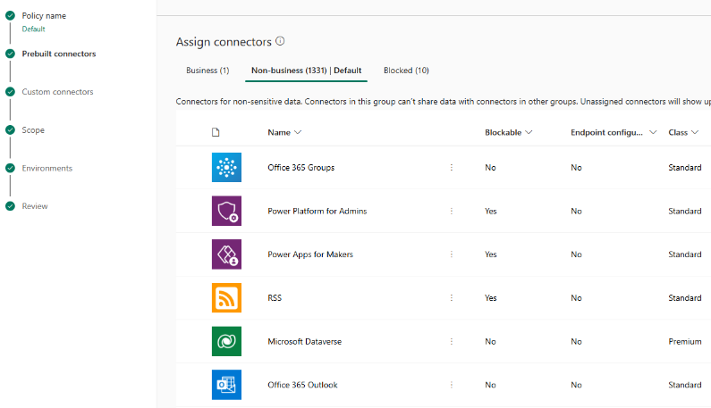
Data Loss Prevention policies
Data Loss Prevention (DLP) policies in Power Platform provides a way to control which Power Platform and Custom Connectors are allowed to be used in Power Platform environment level
Most of the connectors can be blocked completely and policies can also define which connectors can be used in same Copilot Studio agent, Power App and Power Automate flow
Notes:
Power Platform offers a comprehensive set of controls related to data loss prevention (DLP) policies. These policies, as mentioned earlier by Mate, are designed to regulate the use of Power Platform connectors—including over 1,500 standard connectors as well as custom connectors created within Power Platform environments. DLP policies enable administrators to manage and restrict connector usage effectively.
Currently, there are two types of data loss prevention policies available. The classic DLP policies allow for the configuration and blocking of most connectors; however, certain proprietary connectors (24 in total) cannot be blocked using these traditional policies. Recently, advanced connector policies have been introduced in preview mode, associated with environment groups and managed environment functionalities. These advanced policies provide the capability to block all connectors, including those previously exempt.
Both policy types serve similar purposes but differ in their scope and flexibility. Within DLP policies, connectors are organized into three categories: business, non-business, and blocked. Connectors in the blocked category are prohibited from use within the designated environment. If a connector, such as SharePoint or Office 365 Outlook, is categorized as business, it can be utilized together within the same Power App or Flow. Conversely, if a connector like Dataverse is placed in the non-business category, it cannot be combined with business-category connectors in a single agent due to categorical separation.
In summary, this is the framework for configuring data loss prevention policies within Power Platform.

Slide 35
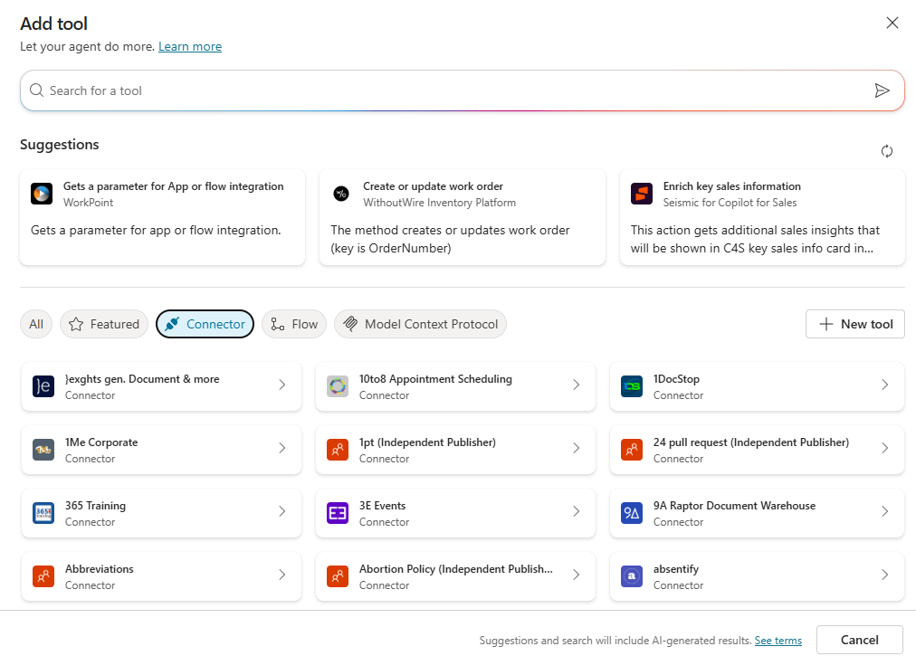
Data Loss Prevention - Agent Connector Controls
Agent can use Power Platform and Custom Connectors as well as Agent Flows as tools
With Power Platform Data Loss Prevention policies, admins can control which connectors are allowed to be used in agent and agent flows
Policy can be applied to required environments
Applies for both declarative and custom engine agents built with full Copilot Studio
Notes:
Connectors let us integrate tools like Power Platform into agents. For example, by adding a send-email connector, the agent can email users based on specific prompts. Data loss preferences and policies specify which connectors, including custom ones, are allowed for our agents. Currently, this option is available only in declarative agents and custom engineering within Copilot Studio.

Slide 36
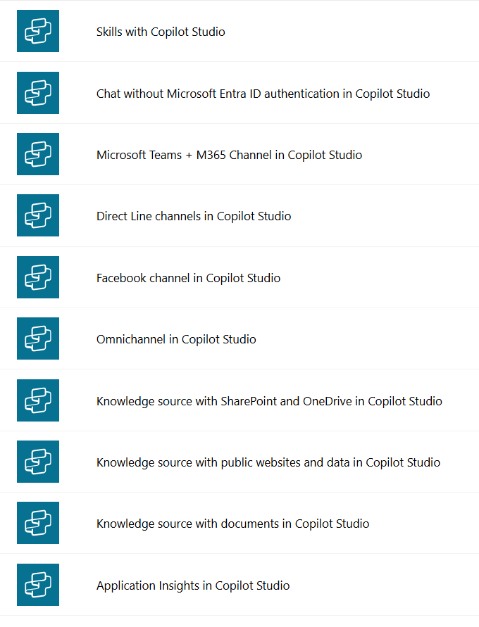
Data Loss Prevention - Block agent publishing
Copilot Studio has several connectors available for different features which can be used in Data Loss Prevention policies
Admins can use policies to disable publishing of agents by blocking the Microsoft Teams + M365 Channel in Copilot Studio connector
Policy can be applied to required environments
Applies for both declarative and custom engine agents
Notes:
Copilot Studio offers around 10 or 11 connectors for various features. For example, there is a connector that manages publishing to different channels. At the tenant level, you can block publishing, but there are also options at the environment level. By applying a DLP policy to an environment, you can prevent publishing agents to specific channels like Teams or Copilot Chat. Connectors exist for many channels, including websites, native apps, email, Facebook, and more, allowing targeted control over publishing for each one.

Slide 37
Data Loss Prevention - Block SharePoint Knowledge Source
Admins can use Data Loss Prevention policies to disable the use of knowledge sources in agents by blocking the
Knowledge source with SharePoint and OneDrive in Copilot Studio (DA/CEA)
Knowledge source with public websites in Copilot Studio (CEA)
Knowledge source with documents in Copilot Studio (CEA)
Notes:
Agents can leverage various knowledge sources, including SharePoint, which is available for both declarative and custom engine agents and can be managed as needed. DLP policies enable you to restrict access to SharePoint knowledge sources or public websites in specific environments, and these controls also apply to document knowledge sources.

Slide 38
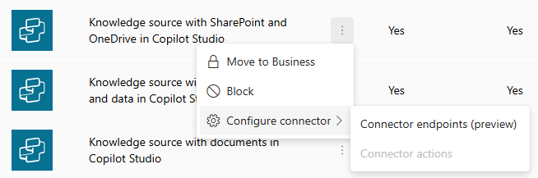


Data Loss Prevention – Connector endpoints (preview)
Following Copilot Studio connectors supports more granular control allowing admins to specify endpoint URLs by either allowing or denying them
Knowledge source with SharePoint Online and OneDrive
Knowledge source with public websites and data
Supports wildcards
Notes:
Connector endpoint filtering, still in preview, allows precise control over SharePoint Online and OneDrive knowledge sources, as well as public websites. With this option in the DLP policy, you can specify which SharePoint sites or public web endpoints are permitted for use by your agent—only those defined are allowed; all others are denied. This ensures agents can access only approved sites as knowledge sources, helping enforce compliance and prevent violations.
Some Copilot Studio connectors support endpoint-level filtering.
Admins can allow or deny specific endpoint URLs.
This is useful for connectors like:
SharePoint and OneDrive
Public websites and data
Wildcards are supported for flexible URL patterns.
Helps enforce granular control over data access.

Slide 39

Sensitivity Labels
How Copilot honors your information protection controls using sensitivity labels and encryption.
Copilot works together with your Microsoft Purview sensitivity labels and encryption to provide an extra layer of protection.
When you use Copilot to create new content based on an item that has a sensitivity label applied, the sensitivity label from the source file is automatically inherited, with the label's protection settings.
Licensing requirement – No auto labelling
Microsoft 365 E3/A3/G3
Enterprise Mobility + Security E3/A3/G3
Notes:
Sensitivity labels apply not only to Copilot and agent features, but also to their handling of content. If a document in SharePoint has a sensitive label restricting access, it overrides direct user permissions, blocking those users even if they have permission. Copilot and agents honor these labels, so if you prompt for content that's restricted by a sensitive label, they will not provide results from that document.

Slide 40


Document sensitivity Labels
How Copilot honors your information protection controls using sensitivity labels and encryption.
When the sensitivity label applies encryption, users must have Extract usage rights, as well as VIEW for Copilot to return the data.
Usage right that determines whether Microsoft 365 Copilot can display text to the user from encrypted content
Notes:
When sensitivity labels apply encryption, Copilot needs specific permissions to access content.
Users must have Extract and View rights for Copilot to return data.
These rights are part of Microsoft Purview Information Protection.
Without these permissions, Copilot cannot display or use encrypted content.
Admins can configure these rights using Microsoft Purview or Azure Information Protection.

Slide 41
Reporting & Monitoring
Notes:
OK, let's jump then to the reporting and monitoring.

Slide 42


Agents Usage (Preview)
The Agent usage report helps you track how agents are being used in Microsoft 365 Copilot Chat and Microsoft 365 apps.
You can see which agents are being used by both licensed and unlicensed Microsoft 365 Copilot users for 7 or 30 days back
You can view usage within an hour from when users interact with agents, and the report includes key metrics such as:
Total active users and agents
Summary and daily time series
Active usage per user, agent and agent-user pair
Notes:
There are several new preview features available. The agent usage report is currently in preview and can be found under M365 admin center in reports usage, with some customers already enabled. This report shows how agents are used in a tenant, including active and licensed users, as well as statistics at both the user and agent levels. However, it does not yet include SharePoint agents and primarily covers declarative agents, not custom engine agents.
I would like to address an important point regarding the agents usage report. If you have access to this feature in the tenant and notice that only a subset of agents appears, please note there is a known issue currently under review. At present, the report displays a maximum of 100 agents, reflecting those used within the last 30 days. For tenants with a large number of agents or significant agent activity, it is likely that only the most recent 100 agents will be visible. Additionally, the export function does not include all agents. Both of these limitations are recognized bugs and are expected to be resolved in a future update, although an exact timeline is not yet available.
The Agents Usage report helps track how agents are used in Microsoft 365 Copilot Chat and apps.
It shows usage by both licensed and unlicensed users.
Data is available for the past 7 or 30 days.
Key metrics include:
Total active users and agents
Summary and daily time series
Usage per user, agent, and agent-user pair
Updates within an hour of user interaction.

Slide 43


Credits Consumption (Preview)
Admins can monitor declarative‎ agents metered use of agents in ‎MAC
Contains usage of declarative agents using organization data or other billable features like tools (MCS agents only) used by users not having Microsoft 365 Copilot licenses
Able to see usage in users, agents and users & agents level
Notes:
There's also a new credits consumption report, which has been available for some time now, although it's still in preview. This report is specifically for declarative agents only. It lets you see credits consumption at both the user and agent level, and it even breaks down usage by billing plan—so if you have multiple billing plans, you can view credits consumed per plan. Note that the report shows only how many credits have been used—not the cost. You can track consumption by billing plan, user, agent, or any combination.
One of the best features of this report is that it's nearly real-time. Coming from the Power Platform world, I've noticed those analytics and reports often have at least a few hours' delay before refreshing, but this report is updated almost instantly, which was a nice surprise. For example, if you test an agent with a user who doesn’t have a Microsoft 365 Copilot license (making them a Copilot chat user consuming credits), you should see that usage reflected in the report within a few minutes. SharePoint agents are also expected to be included in these reports in the future.
This report helps monitor metered usage of declarative agents in Microsoft 365 Copilot.
Tracks usage by:
Users
Agents
Users & Agents combined
Especially useful for tracking usage by users without Copilot licenses.
Shows credit consumption trends over time.
Helps manage costs and optimize agent deployment.

Slide 44

Review credits capacity and consumption (PPAC)
You can monitor usage of Copilot Studio messages in the Licensing > Products > Copilot Studio
You are provided with details in the messages capacity tab for both prepaid as well as pay-as-you-go consumption for the current month, two previous months and last 12 months
Reports can be downloaded as Excel reports
Notes:
Regarding Power Platform reports, consumption reports have been available for some time. If you want to track custom engine agents' credit usage, you can view up to 12 months of data in the Power Platform admin area and export it to XLS. Similarly, the M365 admin center usage report can be exported to Excel. However, note that consumption data often appears with a delay in Power Platform. This is currently the available option for monitoring custom engine agent usage.
Monitor Copilot Studio message usage in Power Platform Admin Center (PPAC).
Navigate to Licensing > Products > Copilot Studio.
View message capacity for:
Prepaid usage
Pay-as-you-go usage
Data available for:
Current month
Previous two months
Last 12 months
Reports can be downloaded in Excel format.

Slide 45


SharePoint Agents Usage Insights
Agent Insights reports in SharePoint Admin Center provides detailed insights on agent usage across sites.​
Lists the number of agents created, along with details on policies such as Restricted Content Discovery and Restricted Access Control associated with a particular site. ​
Report need to be generated supporting maximum 28 days back ​
Can be downloaded for further analysis​
Available also as PowerShell commands​
Start-SPOCopilotAgentInsightsReport​
Get-SPOCopilotAgentInsightsReport ​
Notes:
In the SharePoint Admin Center, you can generate site usage reports and access PowerShell commands for detailed information. These reports provide data on all sites, including the number of agents and their usage across different SharePoint sites.
SharePoint Admin Center provides Agent Insights reports.
Reports show:
Number of agents created per site
Policies like Restricted Content Discovery and Access Control
Reports can be generated for up to 28 days.
Available via:
SharePoint Admin Center UI
PowerShell commands:
Start-SPOCopilotAgentInsightsReport
Get-SPOCopilotAgentInsightsReport
Helps admins govern agent usage and maintain content integrity.

Slide 46

Viva Insights Copilot Studio agents (Preview)
The Copilot Studio agents report in Viva Insights can help you understand the adoption and impact of agents built in Microsoft Copilot Studio that are deployed across various channels within your organization such as:
Custom and demo websites
Microsoft Teams and Microsoft 365 Copilot
Mobile apps
Facebook
Azure bot service channels such as Skype, Twilio, and Microsoft Cortana
Notes:
Viva Insights is set to play a significant role in analytics for Copilot and associated agents. Currently, there is a public preview available for the custom engine agent report. Please note that certain license requirements apply; as detailed in our official documentation, the feature should be accessible to all tenants. However, to view comprehensive data within these reports, at least 50 Microsoft 365 Copilot licenses are required per tenant. Tenants with fewer than 50 licenses may have access but might not see the full report details.
Additionally, a similar report for declarative agents will be released next month, and SharePoint agent reporting is also planned as part of the Viva Insights roadmap. As highlighted in the planned features, Viva Insights will play an increasingly prominent role in Copilot and agent analytics moving forward.
The Copilot Studio agents report in Viva Insights helps track adoption and impact of agents built in Microsoft Copilot Studio.
Covers agents deployed across:
Microsoft Teams
Microsoft 365 Copilot
Custom websites
Mobile apps
Facebook
Azure Bot Service (Skype, Twilio, Cortana)
Key metrics include:
Active agents
Engaged sessions
Agent-assisted hours
Session outcomes and CSAT scores
Excludes:
Declarative agents
Agents built using Agent Builder in Microsoft 365 Copilot
Autonomous agents
Requires:
At least 50 Copilot or Viva Insights licenses
At least one published agent in a production environment
Power BI Desktop (June 2022 or later)
Insights Analyst role in Viva Insights

Slide 47

Copilot Studio Kit
The Power CAT Copilot Studio Kit is a comprehensive set of capabilities designed to augment Microsoft Copilot Studio.
Helps makers develop and test custom agents, use large language model to validate AI-generated content, optimize prompts, and track aggregated key performance indicators of their custom agents.
Main features are:
Agent Inventory
Agent Review Tool
Testing capabilities
Conversation KPIs
SharePoint Synchronization
Webchat Playground
Notes:
The Copilot Studio Kit is a valuable tool developed by our Power CAT team. If you know the COE Starter Kit, this kit is similar. It inventories agents built in Copilot Studio—mainly declarative and custom engine agents—and gathers data from Power Platform environments and most Dataverse tables where agent metadata is stored. Features include inventory management, agent review, testing tools, conversation KPIs, SharePoint sync, and a web chat playground. The slide may need updating if new tools have been added. I recommend checking out the Cobalt Studio Kit for more analytics, insights, and resources to support your agents.

Slide 48

Data Security Posture Management for AI (DSPM AI)
Provides visibility into data security risks and recommend controls to protect data and proactively monitor AI use.
Strengthen organization’s data security and compliance for Microsoft 365 Copilot and Microsoft 365 Copilot Chat
Notes:
Let’s talk about Data Security Posture Management for AI, or DSPM for AI, which is part of Microsoft Purview.
This tool provides centralized visibility into data security risks and helps enforce compliance when using AI tools like Microsoft 365 Copilot and Copilot Chat.
DSPM for AI offers real-time insights into how AI interacts with your data, helping you identify potential oversharing or misuse. It includes preconfigured policies that can be activated with a single click to prevent data loss in AI prompts.
It also runs weekly data risk assessments on your top 100 SharePoint sites and allows you to create custom assessments to monitor sensitive data exposure.
To use DSPM for AI, you’ll need the right permissions and Microsoft Purview auditing enabled. This ensures your organization can adopt AI tools confidently while maintaining strong data protection and compliance standards.

Slide 49


DSPM for AI – Activity Explorer “ View Details”
Activity Explorer Monitor data collected from origination's policies
AI interactions
Sensitive info types
AI websites visit
Prompts and responses can be viewed using “Interaction data” link
Notes:
Let’s take a closer look at the Activity Explorer in Microsoft Purview’s Data Security Posture Management for AI.
This tool gives us detailed visibility into AI-related activity across the organization. It tracks:
AI interactions, including prompts and responses
Sensitive information types involved in those interactions
Visits to AI websites, including third-party tools like ChatGPT
You can view specific prompts and responses using the 'Interaction data' link, which is especially useful for compliance and auditing purposes.
To access this data, users must be assigned the Content Explorer Content Viewer role. This ensures that only authorized personnel can view sensitive AI interaction data.
With this level of insight, organizations can proactively monitor AI usage, detect potential data leaks, and ensure compliance with internal and regulatory policies.

Slide 50

Audit Events of Copilot Studio Activities
Audit log captures events related to administrative actions in Copilot Studio.
Audit log capture events when both admins and users interact with Copilot and AI Applications
Notes:
The audit log lets us track who is using Copilot and agents, and which features they access. While we don't have prompts and responses recorded, agent usage information is available.

Slide 51



Audit Logs Captured Copilot Studio Activities
agent authoring
Audit logs capture activities performed by administrators, such as change to Copilot settings, plugins, or workspace
Copilot Activities captured examples:
Creating a new Copilot Plugins
Deleting an agent
Updating an agent's name, details, configuration
agent usage
plugins
Notes:
We currently track copilot interaction events, including user engagement with Copilot or agents. This also covers agent-related activities—such as creating or deleting agents in Copilot Studio, as well as adding AI block insurance—which are now recorded as distinct event types. Additionally, our roadmap includes plans to introduce new copilot and agent events to the audit log later this year.

Slide 52
Planned Features
Notes:
Let us review several planned features, which are outlined in the public roadmap.

Slide 53
Recent control updates
496363 - Microsoft 365 Admin Center: Agent-Level Controls for Pay-as-you-go (December 2025)
Administrators can specify which users can access particular agents through pay-as-you-go, control which agents are available for metered consumption, and establish billing policy for each agent. Initially focusing on declarative agents in M365 Copilot Chat and SharePoint, this enhancement enables organizations to effectively manage AI consumption costs and scale intelligent capabilities according to business needs.
1138797 - Microsoft Copilot (Microsoft 365): New admin control in Microsoft 365 admin center for org-wide sharing of user-built Copilot agents (October 2025)
Microsoft 365 is introducing a new tenant-level admin control to manage who can create org-wide sharing links for user-built Copilot agents. Rolling out from October to late October 2025, admins can customize sharing permissions to align with organizational policies via the Microsoft 365 admin center.
502867 - Microsoft 365 admin center: Agent Ownership Reassignment (October 2025)
Admins can reassign ownership of shared agents created within the organization through tools such as Copilot Studio or the Microsoft 365 Agents Toolkit. Once reassigned, the new owner will gain full edit and delete permissions, along with access to any files uploaded by the previous owner. The former owner will lose all access, including read rights.
Notes:
Searching for "Copilot control system" or "agents" on the M365 roadmap now returns over 50 relevant items. Recent updates introduce agent-level pay-as-you-go credit limits in the MRA65 admin center, starting with custom engine agents and declarative agents created in Copilot Studio. Soon, all declarative agents will be included in the admin center, letting admins manage these limits. Additionally, a new control will allow admins to restrict who can create organization-wide sharing links in Copilot Studio Lite, enabling more granular sharing options for agents. Starting next month, admins will also be able to reassign ownership of orphan or ownerless agents directly from the Copilot control system.

Slide 54
More recent control updates
480729 - SharePoint: SharePoint agent usage statistics across all SharePoint sites (December 2025)
SharePoint agents' usage statistics would be aggregated across all SharePoint sites and available for the tenant admin persona.
480725 - SharePoint: Agent usage statistics per SharePoint site (November 2025)
SharePoint agents' usage statistics will be available for every SharePoint site. This will be available on the site analytics page for the site owner persona. This will also include analytics on how many times source files are cited.
480726 - Microsoft Viva: SharePoint agent analytics on Viva Insights (December 2025)
Explore how your employees used key SharePoint agent features over a given time period and understand the ROI.
498227 - Microsoft Purview compliance portal: Audit logs for agent management in Microsoft 365 admin center (October 2025)
Track and audit agent-related admin actions in Microsoft 365 admin center via Purview unified audit logs. This feature enables visibility into agent configuration changes—such as publishing, blocking, updating, or removing agents. Integrated with Purview’s audit search and reporting tools, it helps organizations meet regulatory standards and maintain oversight of agent management.
Notes:
Regarding SharePoint agents, we are enhancing visibility into usage statistics across all sites. For instance, SharePoint administrators will be able to access comprehensive analytics in the SharePoint admin center, detailing how SharePoint agents are utilized throughout the tenant and within individual sites. Site owners will also have access to site-specific agent usage reports, allowing them to analyze how agents are leveraged in their respective environments.
Analytics will play a significant role moving forward. As previously mentioned, SharePoint agent analytics are expected to become available by December. Additionally, a public preview for declarative agents is anticipated next month, which means we will soon support agents, custom engine agents, and SharePoint agents within Viva. This progression should provide us with highly granular data on agent activity.
In Microsoft Purview, enhanced audit log events for agent management are being introduced. These admin-level events will give administrators greater control over agents, including actions such as deleting, blocking, or deploying agents within their management scope. Such activities will be recorded and accessible via the audit log.
Furthermore, participation in the public program is encouraged for additional insights. Notably, at least two Graph APIs are forthcoming: one for management and another for usage data. The management API will enable automation of administrative tasks currently performed through the UI, and may eventually be complemented by PowerShell cmdlets or modules for more streamlined agent inventory management. This will facilitate automation through custom scripts or Power Automate flows that interact with the Graph API. The second API will provide access to the same usage data found in the agents’ preview reports, supporting custom reporting and extended analytics capabilities.

Slide 55
Next Steps and Call to Action
Notes:
Next steps and call to action.

Slide 56





Agent Governance & Cost Controls
Administering & Governing Agents E-book
Confidently adopt and administer Microsoft Copilot Studio with managed security and governance
Microsoft as Customer Zero: The Employee Self-Service Agent Roll Out
Cost Control Blog : Take Control of Agent Costs
Cost Control Ebook : Agent Cost Management
Notes:
This slide contains a series of helpful links on this topic, including ebooks and white papers. Resources include an ebook for administering governing agents, several useful links, a Microsoft case study on agent rollout, a blog post and ebook on cost control. These links are clickable via PowerPoint Live.

Slide 57




Visit Customer Hub website for upcoming sessions, updates, and on demand contents!
https://aka.ms/CustomerHubSessions​
Notes:
Additionally, upcoming customer hub sessions are available at the designated Customer Hub Sessions page.

Slide 58
Thank you

